Slide 1
District 96 | Judges’ Training
Presenter:
District 96 Chief Judge - Carole Murphy, DTM
January 18, 2025

Slide 2
Introduction
Purpose of Toastmasters speech contests:
Provide competitive speaking experience for Toastmasters members
Provide interesting education programs for members and the public
Provide the audience an opportunity to learn by observing proficient speakers
“Good judging imparts a feeling of fairness to the contestants and the audience and that the right choice was made”

Slide 3
By the end of this module, you should be able to fulfill your duties and responsibilities as one of the following:
The Chief Judge
  Organize and run CLEAN and FAIR speech contests with impartiality
Voting Judge
  Successfully cast a ballot objectively to determine the BEST speaker in the contest to represent your “club” or your “area” or your “division”
Ballot Counter
  Successfully collect ballots from voting judges
  Tabulate the results from ballots
Timer
  Successfully time and record all speech contestants
  Follow timing conventions for the entire speech contest

Slide 4
Eligibility Requirements for all Judges
To be a Chief Judge, Voting Judge or Tiebreaking Judge at a Toastmasters speech contest, you must meet the following eligibility requirements:
Club Contest:
Be a paid member
Area, Division, or District Contest:
Be a paid member for a minimum of six months
Completed a minimum of six speech projects in Competent Communicator OR
Earn certificates of completion in Levels 1 and 2 of any path in Toastmasters Pathways
Be physically present at the contest for which you are serving

Slide 5
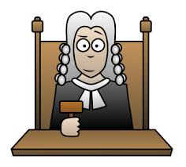
Training Objectives
Responsibilities of the Chief Judge:
Refer to the 2024-2025 Speech Contest Rulebook and other contest resources.
Appointment and counsel of voting judges, ballot counters, timers, and a secret tie-breaking judge.
Judges’ Briefing (voting judges, ballot counters, timers).
Tie-Breaking Judge’s Briefing.
Protests and Disqualifications.
Oversees ballot counting.
Notification of contest winner(s).
Destruction of ballots and tally sheet.

Slide 6
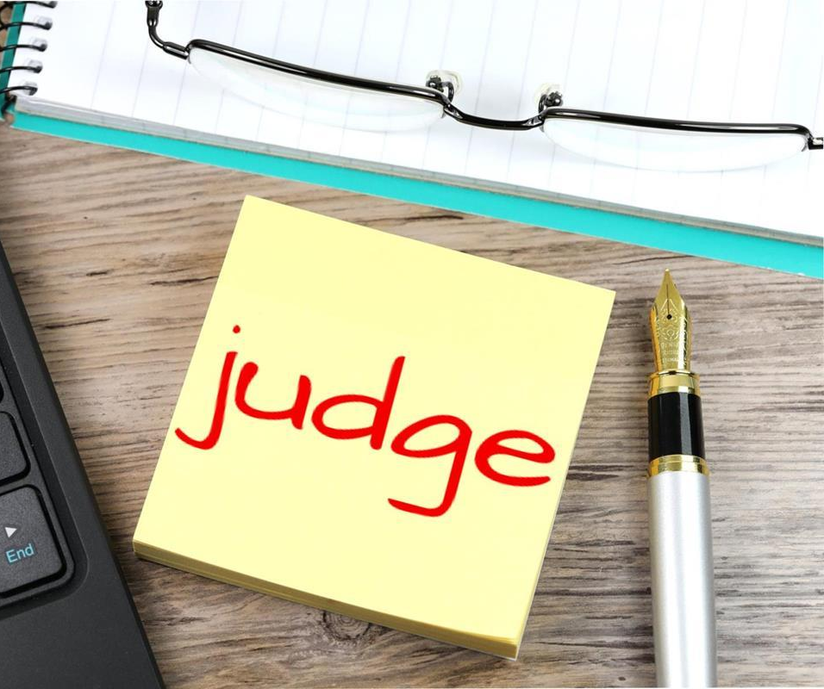


More Training Objectives
Responsibilities of a Voting or Tiebreaker Judge
    Know the criteria of the Judge’s Guide and Ballot
    Completion of a valid ballot
    The right to launch a protest
Responsibilities of Ballot Counters
                Ballot collection
                Ballot counting process
Responsibilities of Timers
    Timing role
    Timing guidelines
    Recording of speech times

Slide 7
Speech Contest Rulebook and Other Contest Resources
Familiarize with and use the July 1, 2024 to June 30, 2025 Speech Contest Rulebook as your primary source for all speech contests
      The Speech Contest Rulebook is protocol and applies to ALL official Toastmasters speech contests
      Here is the link:. https://ccdn.toastmasters.org/medias/files/department-documents/speech-contests-documents/1171speechcontestrulebook2024-2025/1171-speech-contest-rulebook.pdf
Other resources from Toastmasters International you should refer to as your secondary sources include:
      Speech Contest Tutorials: https://www.toastmasters.org/leadership-central/speech-contests/speech-contest-tutorials
      Chief Judge: Contest Checklist: http://www.rodneydenno.com/DOCS/Chief-Judge-Contest-Checklist.pdf
      Speech Contest Judges Training (1190): https://www.toastmasters.org/resources/speech-contest-judges-training
Carole Murphy, DTM - District 96 Chief Judge: Email: mjcarol@telus.net

Slide 8
Appointment and counsel of voting judges, ballot counters, timers, and a secret tiebreaking judge
  Club Contests:
  At least 5 voting judges, a tie breaking judge, two counters, and two timers are appointed unless it is impractical.
Area Contests:
  An equal number of voting judges from each Club in the Area or a minimum of 5 voting judges, a tie breaking judge, two counters, and two timers must be appointed.
Division Contests:
  An equal number of voting judges from each Area in the Division or a minimum of 7 voting judges, a tie breaking judge, two counters, and two timers must be appointed.
Note : No Chief Judge, Voting Judge, or Tiebreaking Judge must be a member of any club in which a contestant is a member.

Slide 9
Judges Briefing – Voting Judges
  Anonymity of Voting Judges
      Voting judges at all levels MUST remain anonymous when practical
      Good judges are: Accurate, Fair, Trustworthy, Knowledgeable, and Good Listeners
  Judge’s Certification of Eligibility and Code of Ethics
      Each voting judge receives the Judge’s Certification of Eligibility and Code of Ethics form and MUST complete, sign, date, and return the form to the Chief Judge.
  Judge’s Guide and Ballots for Voting Judges
      Before each contest, the chief judge will hand out the appropriate judge’s guide and ballot to every voting judge for the contest
  Speaking Order of Contestants
  Right to Launch a Protest (based on originality)

Slide 10
Judges Briefing – Voting Judges (continued)
Review the Judge’s Guide and Ballot and Speaking Area:
      Review judging categories/criteria (e.g. content, delivery, language) and the use of the guide for each ballot.
      Stress the importance of objectivity when marking ballots. Review potential bias and subjectivity of speakers such as the halo effect, speaker position, champion for the underdog, second time around, reverse halo effect, and prejudices and personal preferences.
      Marking of ballots – valid vs invalid. Review how each ballot is to be completed for each contest – the top and the bottom portions of the ballot. NB: The chief judge DOES NOT judge contestants.
      Placement of completed ballots (the bottom portion) in envelopes.
      Where to destroy the top portion of the judge’s guide and ballot.
      Instruct voting judges on where to sit during the contest.

Slide 11
In Summary
  Be discreet
  Familiarize yourself with the judging categories/criteria (e.g. content, delivery, language) on the judge’s guide and ballot for each contest.
  Sit close to the contest area.
  Be objective when marking the ballot. Your job as a voting judge is to select the “best speaker” at the contest.
  Strategize in ranking each contestant and take as much time as needed to complete the ballot.
  For a ballot to be valid, the bottom portion must be completed as follows:
      Print and sign your name on the ballot
      Rank the first place, second place, and third place contestants (if applicable)
  Completed ballot in an envelope to a Ballot Counter.
  Discard and destroy the top portion the judge’s guide and ballot away from the contest venue.
  DO NOT share your ballot results with anyone.
  The right to launch a protest based on originality.

Slide 12
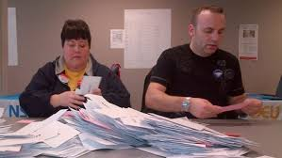
Judges Briefing – Ballot Counters
  Review the duties of a ballot counter:
      Provide a listing of voting judges
      Collecting completed ballots in envelopes from voting judges
      Counting room procedure – tabulating and computing the results for each contestant on the Counter’s Tally Sheet
      DO NOT share results with anyone

Slide 13
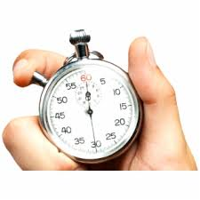
Judges Briefing – Timers
Review the duties of a timer:
      Division of timing roles between two timers
      The use and display of signaling devices to contestants and contest chair
      In the event of technical failures of timing devices or equipment
      Timing guidelines for each contest:
        When to start timing and when to stop timing
        Speech contest timing parameters for each type of contest (e.g. International and Table Topics contests)
      Speaking order of the contestants
      Recording and completing the Speech Contest Time Record sheet (Item 1175)
      Submission of the Timing Record Sheet in envelope
      DO NOT share the timing results with anyone

Slide 14

Tiebreaking Judge’s Briefing
  Anonymity of the Tiebreaking Judge
      The identity of the tiebreaking judge is secret and is only
      known to the chief judge.
      The tiebreaking judge DOES NOT attend judges’ briefing
      The chief judge will brief the tiebreaking judge separately
  Judge’s Certification of Eligibility and Code of Ethics
      The tiebreaking judge receives the Judge’s Certification of Eligibility and Code of Ethics form and MUST complete, sign, date, and return the form to the chief judge.
  Tiebreaking Judge’s Guide and Ballot
      Before each contest, the chief judge will hand out the appropriate tiebreaking judge’s guide and ballot to the tiebreaking judge for the contest:
      Instruct the tiebreaking judge to rank ALL CONTESTANTS in placement order
      The chief judge will personally collect the tiebreaking judge’s ballot
      DO NOT share your ballot with anyone

Slide 15
Protests and Disqualifications
  Protests
    Are limited to eligibility, originality and reference to another contestant or another contestant’s speech.
    Must only be lodged by voting judges and contestants.
    Must be lodged with the chief judge and/or contest chair prior to the announcement of the winner and alternate(s).
    Cannot be lodged by audience members.
  Disqualifications
    The contest chair can disqualify a contestant on the basis of eligibility.
    The chief judge can disqualify a contestant based on timing.
    When a protest is launched for originality, either by a voting judge or contestant, the chief judge will confer with all voting judges in a private meeting room.
    After discussing the merits of the protest for originality, the contestant in question must be given the opportunity to respond to the voting judges before he/she can be disqualified.
    After a vote, the majority of voting judges must concur in the decision to disqualify.
    All decisions of voting judges and qualifying judges are final.

Slide 16
Oversees Ballot Counting
Procession to Counting Room
      After all the ballots have been collected the chief judge and ballot counters will leave the contest area and proceed to the counting room
Overseeing of Counting Process
    The chief judge oversees the counting process where the ballot counters will:
      Tabulate the results of the contest using the Counter’s Tally Sheet
      Sees that all ballots are counted TWICE to ensure accuracy
      Hand over the Counter’s Tally Sheet to the chief judge after all the results had been tabulated
Tiebreaking Judge’s Ballot
      In the event of a tie, the chief judge will consult the tiebreaking judge’s ballot to “break” the tie

Slide 17
Results Form, Winners’ Certificates, and the Notification of Winner
Once all the points are tabulated, entered, and computed on the bottom of the
counter’s tally sheet, the chief judge will:
    Record the full names of the winners in reverse order on the Results Form
    Record the ranking of all contestants on the Notification of Contest Winner form.
    NB: The chief judge must submit this form to the contest chair who will be
    presiding the speech contest at the next level.
    Have a calligrapher complete the winners’ certificates for the first, second, and third place winners
    Re-enter the contest area and confer with the Contest Chair re: any disqualifications (of contestant) from the contest
    Give the Results Form and winners’ certificates to the Contest Chair, which he/she will announce the winner(s)

Slide 18

Awards Protocol
  ***In contests with three or more participants, a third place winner, a second place winner, and a first place winner will be announced
  **In contests with less than three participants, a second place winner (if applicable) and a first-place winner will be announced
  *If there is only one contestant, the contestant must be disqualified if he/she does not meet the timing, originality, and/or eligibility requirements

Slide 19

Destruction of Ballots and Tally Sheet
  The chief judge will keep all ballots and the tally sheet until after the winner is announced.
  After the winners have been announced, the chief judge will discreetly destroy all ballots, the time record sheet, and the counter’s tally sheet.

Slide 20
Resources
Carole Murphy, DTM PDD, 604.219.3619 or mjcarol@telus.net
Speech Contest Rulebook – July 1, 2024 to June 30, 2025 (1171)
Toastmasters International Speech Contest Tutorials
Contest Chair Checklist (Rulebook page 26)
Chief Judge Checklist (Rulebook page 29)
Speech Contest Judges Training (1190)
International Speech Contest Ballot (1172)
Table Topics Speech Contest Ballot (1180)
Online Speech Contest Ballot (1189a)
Speech Contest Article: https://d96toastmasters.ca/article/contests/speech-contests-2024-2025

Slide 21
In Summary
Be organized & discreet.
Connect with the Contest Chair.
Have all your forms ready to go.
Align all your judges, ballot counters, and timers.
Have backup judges, timers & ballot counters.
Be very familiar with the Speech Contest Rulebook and other valuable contest resources.
Ask for help/assistance.
Best Wishes and Good Luck with your contest!

