Slide 1
Pathways Learning Experience
District 96
Club Management Curriculum
Facilitator(s):
Maureen McBeath, Janice Parkinson
Date: October 22, 2018
Notes:
Red text
Slides with information, ideas and suggestions. These are all hidden and can be removed before completion of the material
“Instructor’s Tips” for module designers also appear in speakers notes. These can be removed or replaced by notes to instructors on the particular slide if needed
The purpose of the template is to follow instructional design principles and promote consistency across the D96 curriculum
Black text
This provides examples and descriptions that module designers will modify as they create their material

Slide 2

Complete Level 1
Notes:
This is one of _____________ modules designed to help Toastmasters members with the Pathways learning experience. Members may be new or older members transitioning from the Traditional program. Members may be club officers, base camp managers, mentors or a club member.

Slide 3
Agenda
Introduction
Walkthrough
Q & A
Notes:
Module development process
Select a topic
We have a prioritized backlog where you can add topics and see if others want to co-create a module with you
Propose a module
Research resources and draft a ‘D96 TTT Proposal’
Review it with the D96 TTT team to fill in details and get ideas
Design and develop the module
Write objectives and evaluation criteria first
Develop the materials (deck, prework, worksheet etc)
Plan a review cycle or two with others on the D96 TTT team
Deliver the module
Send participants prework and survey (to clarify audience needs)
Ensure participants complete an evaluation
Run a post-mortem with the TTT team and evaluate how to improve it

Slide 4
Introduction
Who are we?
  Toastmaster members before/after March 20, 2018
What are we talking about?
  How to do the Ice Breaker
  How to complete Level 1
Notes:
<Instructor’s Tips>
Clarify the assumed target audience, based on curriculum personas
Introduce the topic with a compelling story or bold statement to generate immediate interest
Adults need a clear statement of the personal benefit to them
I think the topic here is to answer questions, but you could also have a story about a person/club who went from frustration to success
This is you answer WIIFM (what’s in it for me?) for each audience
Members may be new or older members transitioning from the Traditional program. Members may be club officers, base camp managers, mentors or a club member.

Slide 5
Example questions to be answered today
Can I go back to my project once I’ve finished it? (yes)
How many speeches in Level 1? (4)
How does the Ice Breaker get marked complete? (slides 17-21)
How does the Level get marked complete? (slides 23-27)
Which speeches can transfer from the traditional Program to Pathways? (icebreaker)
Can one speech count toward more than one project? (no)
______
______
Notes:
Instructor’s Tips
This is a set of questions this module will answer - review with participants and have them add any questions they have on a topic.
The goal is to engage participants, have them personalize material to their situation, and for the instructor to learn about the participants
You could include an activity to lead into the course here
The survey should impact the module’s focus for each audience
This discussion will lead into the objectives, which come next
We need some sample pre-work/survey templates

Slide 6
Learning Objectives
By the end of this module, you should be able to:
  Launch a project
  Complete a project
  Complete a level
Notes:
Instructor’s Tips
Keep the objectives to a minimum for clarity
Write objectives with a measurable verb (eg. Demonstrate/describe instead of understand/know). Avoid words like ‘effective’ that are open to interpretation
Define evaluation criteria for each objective before you create the module to focus the material to maintain focus throughout
Consider: what behavior change you are seeking by the end of the module?
Expert facilitators: relate to comments/experiences from learners described in the prework
Consider the performance objectives, too: what will people be able to perform when they leave the session
Instructor guidance on module material
Write/speak with supportive/inspiring language to help people believe they can succeed (focus on what they can do, not what they can’t)
Early on, grab attention or provoke to and motivate interest (or get people involved in a task)
Practicing is critical to learning—modules need activities, feedback (WWW/EBI), review, assessment.
Share your experiences/stories and draw in those of learners to make it relevant (adults learn better if they can tie ideas to past experiences)
Content should support learning objectives and nothing else, periodically refer back to the objectives
Don’t make assumptions about how people will feel/respond (eg. ‘easy’)
Use plain language define any specialized terms (maybe include a glossary)
Examples (for illustration), analogies (for clarity) and stories (for rapport and connection) are very effective. Use several around a single situation throughout a module to reinforce material

Slide 7
Level One: Four speeches, one evaluation
Ice Breaker (4 – 6 min)
  Introduce yourself (Optional, share why you joined TM)
Evaluation and Feedback part 1: Speech (5 – 7 min)
  Deliver a speech on any topic
Evaluation and Feedback part 2: Speech (5 – 7 min)
  Repeat the last speech, incorporating evaluation feedback
Evaluation and Feedback part 3: Evaluation (2 – 3 min)
  Evaluate a speech – a member will evaluate your evaluation
Researching and Presenting (5 – 7 min)
  Deliver a speech using research and sources
Notes:
This level is the same for every path - so it doesn’t factor into deciding which path. Completing these projects in Level one is what this presentation is all about. We go into details on the ice breaker. Details about the Evaluation and Feedback project. Quick mention of Researching and Presenting. The Traditional CC Program equivalents are: CC #1 – Icebreaker, CC #2 and CC #7

Slide 8
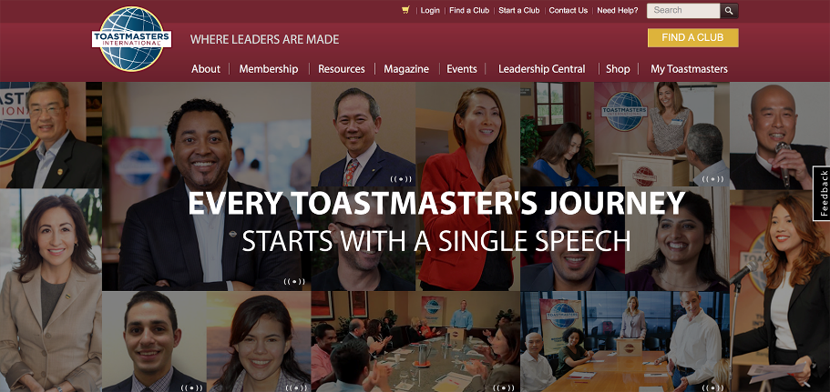
Login to toastmasters.org

Slide 9
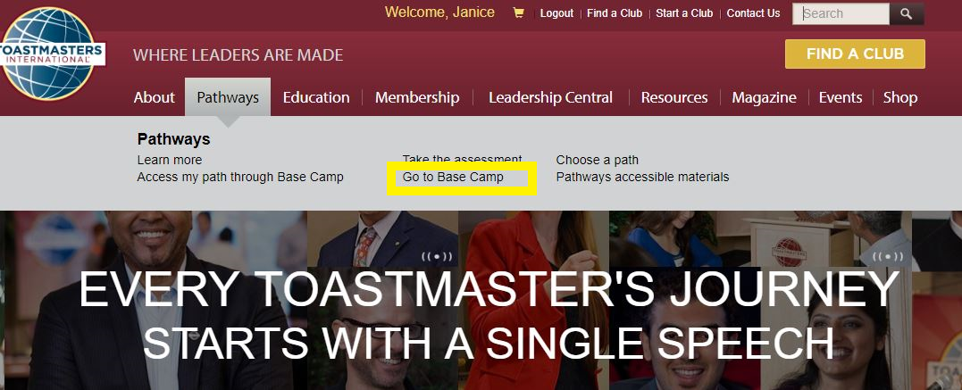
Go to Base Camp

Slide 10
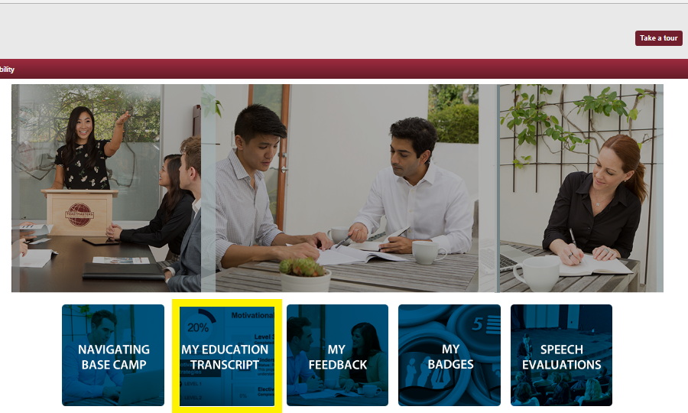
Open my Education Transcript

Slide 11
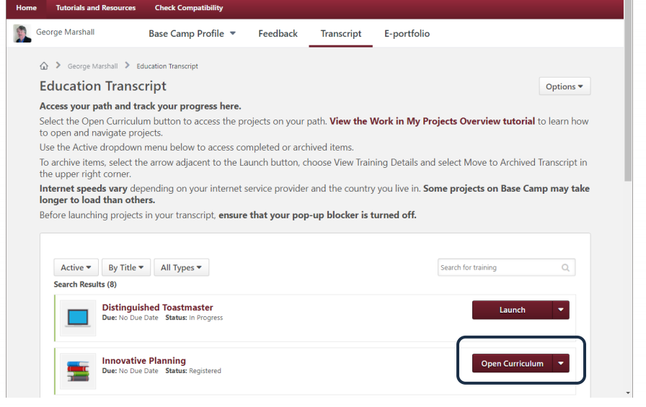
Open my path curriculum

Slide 12
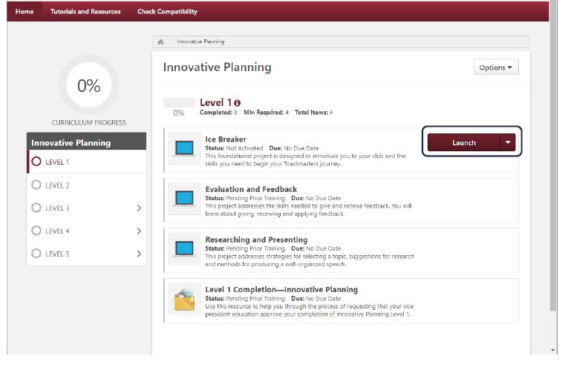
Launch my Ice Breaker project

Slide 13
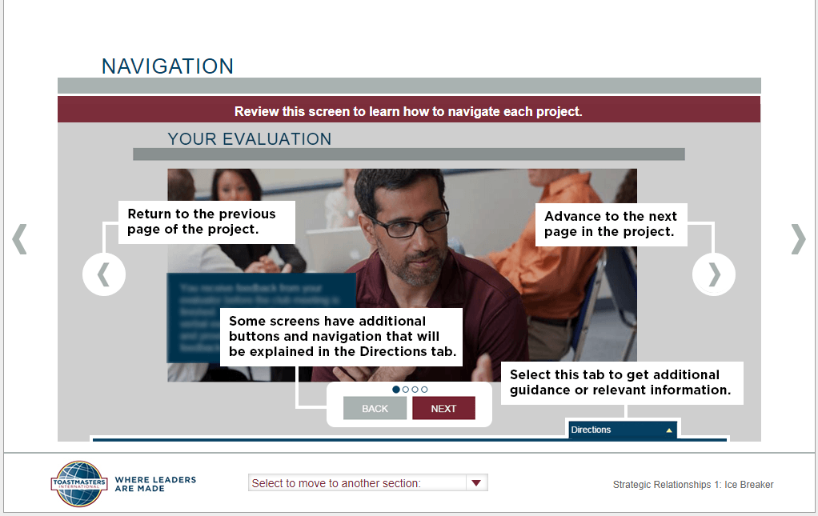
Maximize my popup window
Notes:
People get lost because the navigation controls aren’t always displayed correctly. EMPHASIZE seeing the TWO arrows going left and right. Only the outermost work. EMPHASIZE seeing the drop down list “Select to move to another section”.

Slide 14
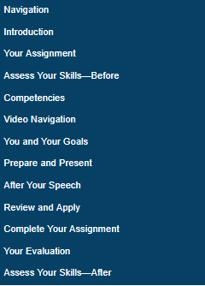
Work through the project in sequence

Slide 15
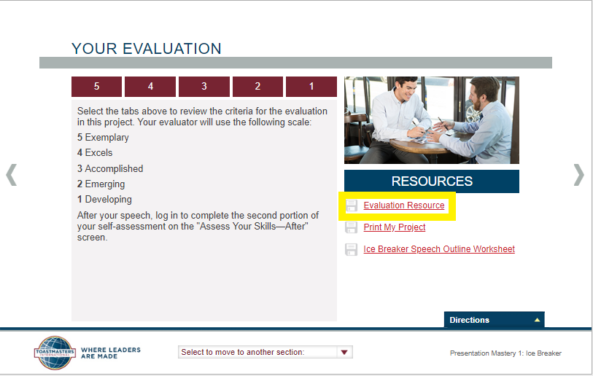
Print the evaluation form
Notes:
Print the evaluation form and take it with you to your club meeting. Your VP of Ed may have the evaluation forms available, you may be responsible yourself. You might email the evaluation pdf to your evaluator. A lot depends on the club norms. < If the club VP Ed is present – ask them what the protocol for the club is >

Slide 16
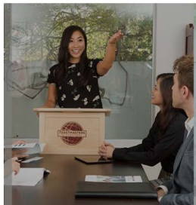
Deliver the speech at your club
Notes:
Collect your evaluation form from your evaluator. Speak with the evaluator before and after speech – Normal evaluation process – this is no different between traditional and pathways education program.

Slide 17
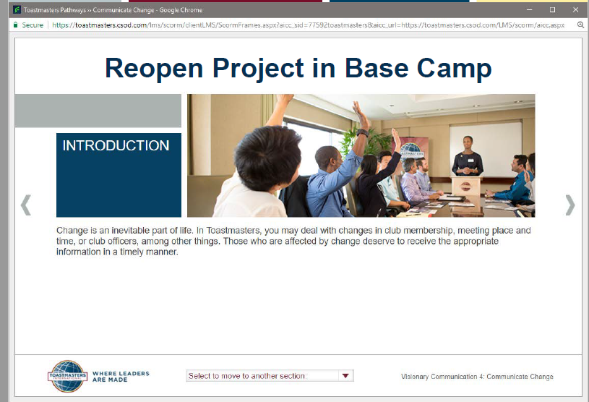
Reopen your project in Base Camp
Notes:
When reopening the project - Launch the popup dialog again - MAXIMIZE the window so you can see the navigation controls. The dialog will return to where you last left it - so you may have to navigate ...

Slide 18
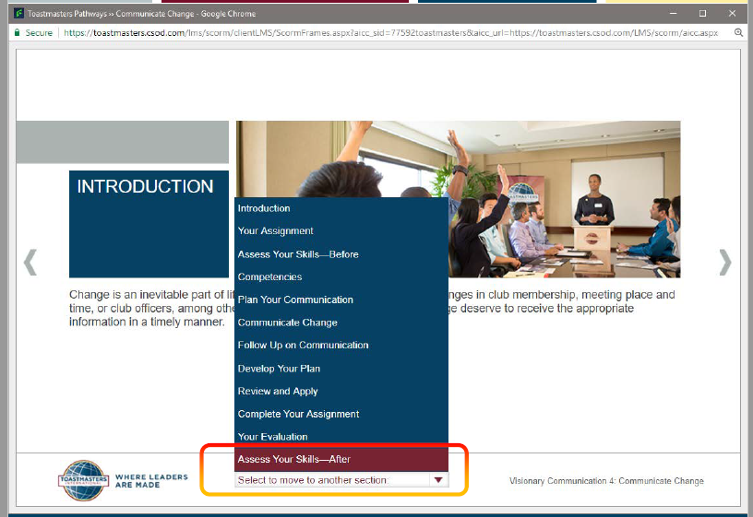
Navigate to Assess Your Skills-After

Slide 19
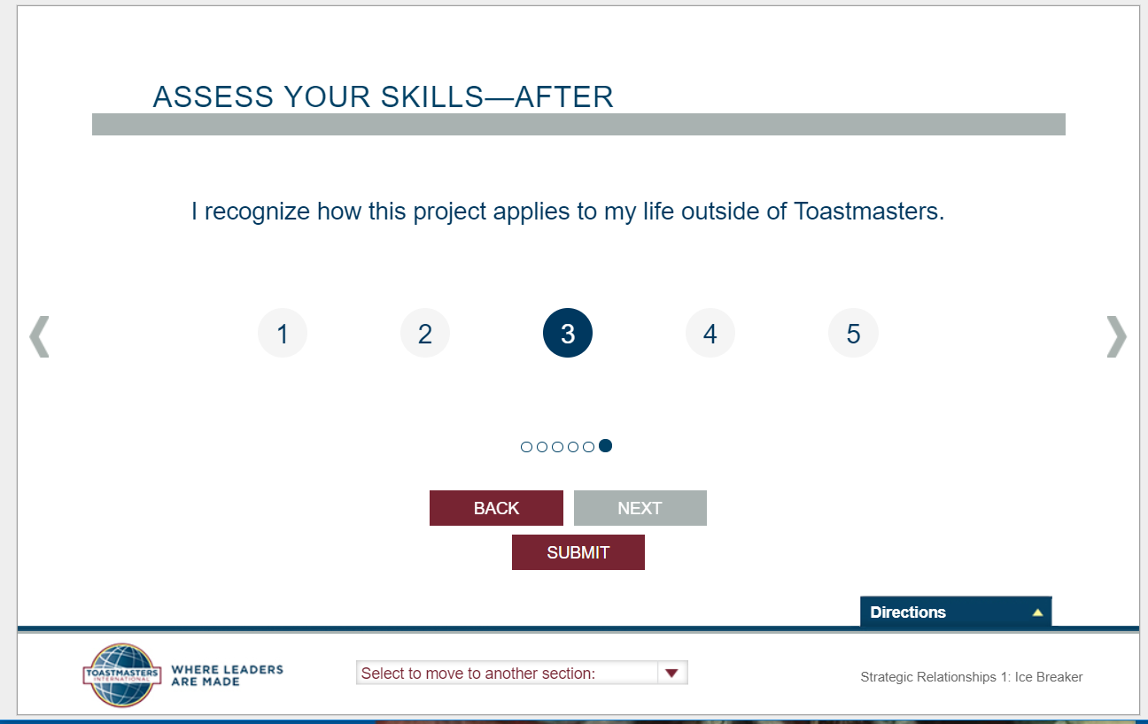
Submit your self-assessment
Notes:
After the project “Assess your skills – After” has been submitted. Click the submit button. ….

Slide 20
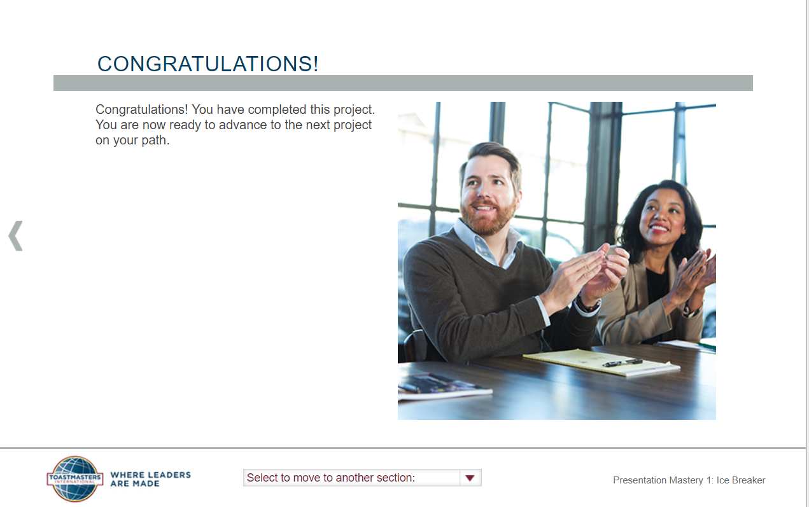
Congratulations!
Notes:
You will see this congratulations page. Close the popup window now…and then you will see your curriculum page again. … next slide

Slide 21
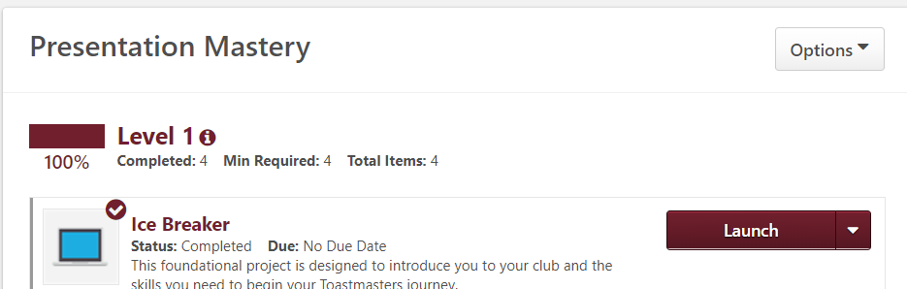
The Ice Breaker is completed!
Notes:
It should then show the tick mark beside the Ice breaker project. The curriculum page may be “hiding” behind other windows, and it may need refreshed to show the completion tick. If you do all that and it still doesn’t show complete – it means you haven’t viewed every item in ice breaker project, or you didn’t actually submit the after assessment. Try again.
the launch buttons are now available for the evaluation and feedback, and the research projects.

Slide 22
Level One - Complete Three Projects
Project 1 : Ice Breaker (4 – 6 min)
  Introduce yourself (Optional, share why you joined TM)
  Must be completed first
Project 2: Evaluation and Feedback
  Part 1: Speech (5 – 7 min)
    Deliver a speech on any topic
  Part 2: Speech (5 – 7 min)
    Repeat the last speech, incorporating evaluation feedback
  Part 3: Evaluation (2 – 3 min)
    Evaluate a speech – a member will evaluate your evaluation
Project 3: Researching and Presenting (5 – 7 min)
  Deliver a speech using research and sources
  Can be done before project 2 if desired
Notes:
Level 1 Consists of 4 speeches and an evaluation. The process to complete the Evaluation and Researching projects is just like the Ice Breaker. Work through all the screens and items in the project, submit the “after project” assessment. See the “tick” beside the project name appear indicating it has been done.
The evaluation tutorial available is AWESOME, and worth the hour of time to do. Expect a member to complete level one in one to six months. Next levels build on skills learnt - with level 5 culminating in a two projects, each of which would take several months to complete.
The Researching and Presenting Speech is very similar to CC #7 - If someone is working in the traditional program - they could present the same speech for both project - they must just give the speech twice; and maybe tweek it a bit to meet the criteria of the different projects. Toastmasters does not give multiple awards for the same speech or activity.

Slide 23
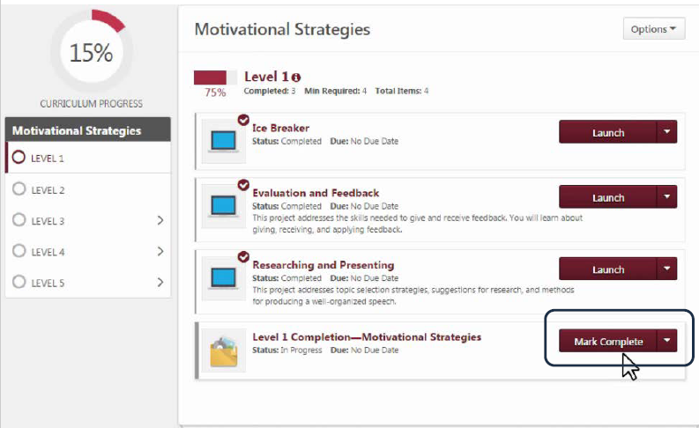
Mark Level One complete in Base Camp
Notes:
Must click on “Mark Complete” it does not happen automatically. Now is time to talk to your VP of Ed to inform them you have completed the level.
The status is “Pending Completion Approval” - until the Basecamp manager approves the request. Level 2 doesn’t become available until after the Base Camp Manager approves the request to complete Level 1.

Slide 24
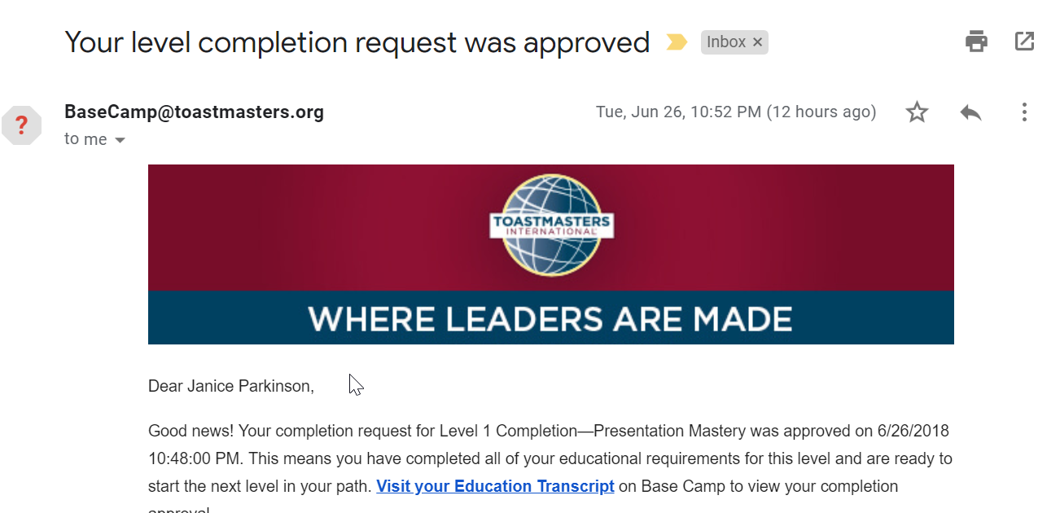
Receive an email after Level is approved
Notes:
This email is sent to the email address on your profile in Club Central when the base camp manager approves the level.

Slide 25
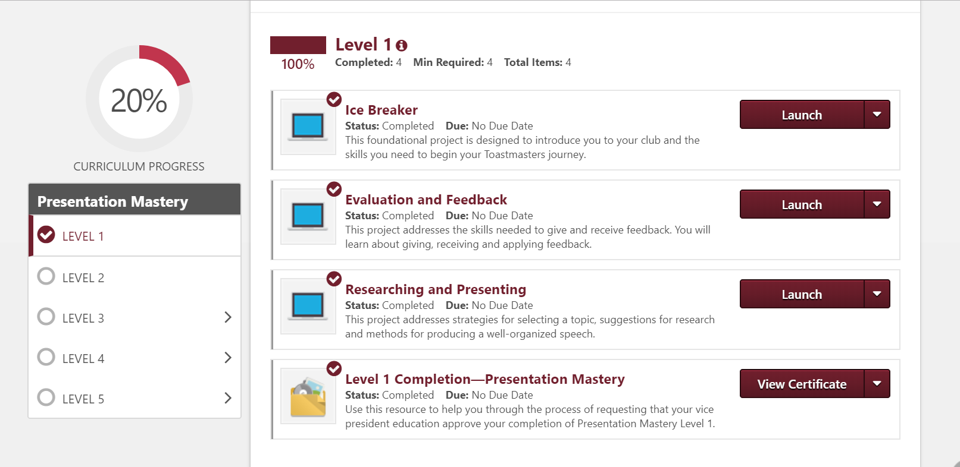
View Certificate for Level 1 completion

Slide 26
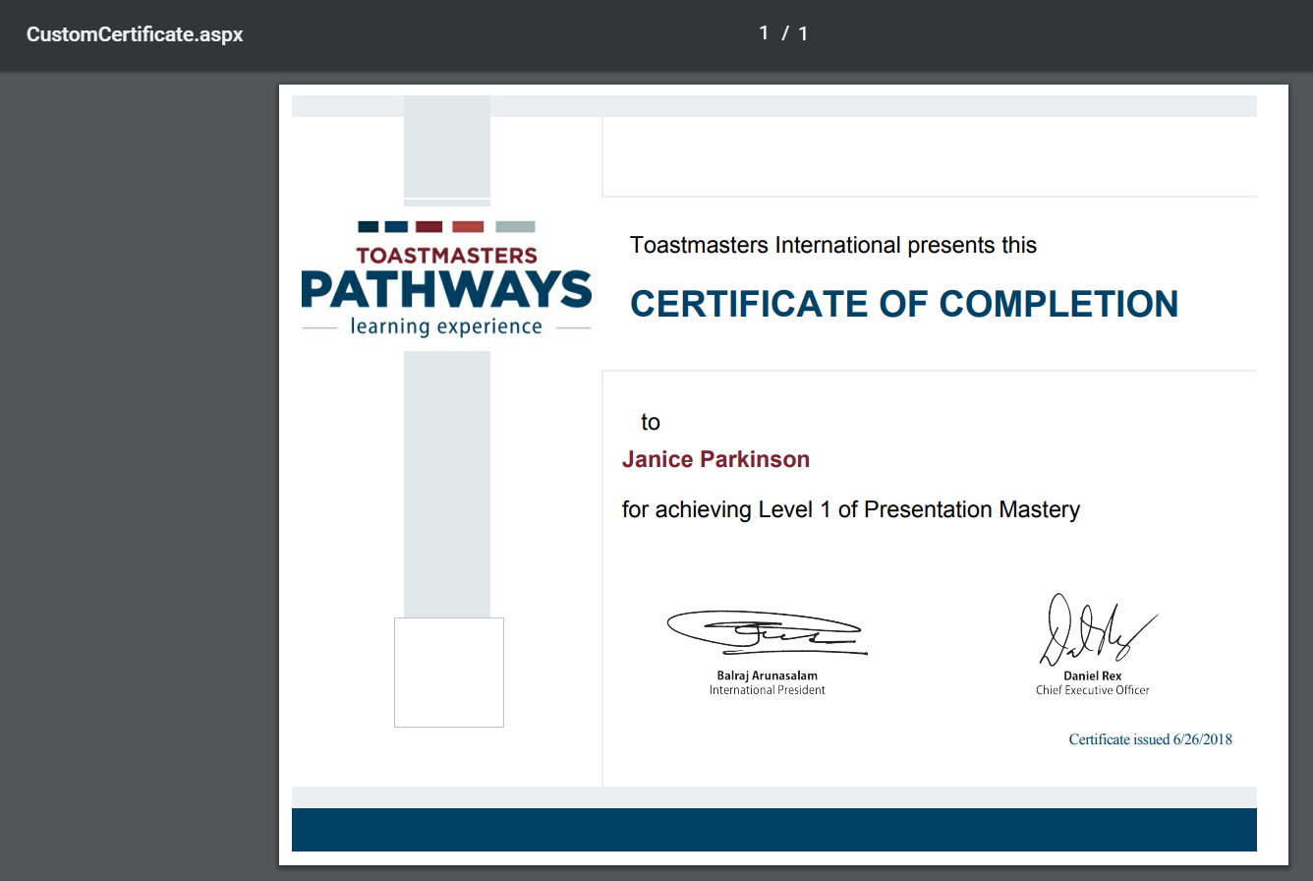
View (and Print) Certificate of Completion
Notes:
VP of Ed (Base camp manager) or member can do this
The club can award a ribbon for completion

Slide 27
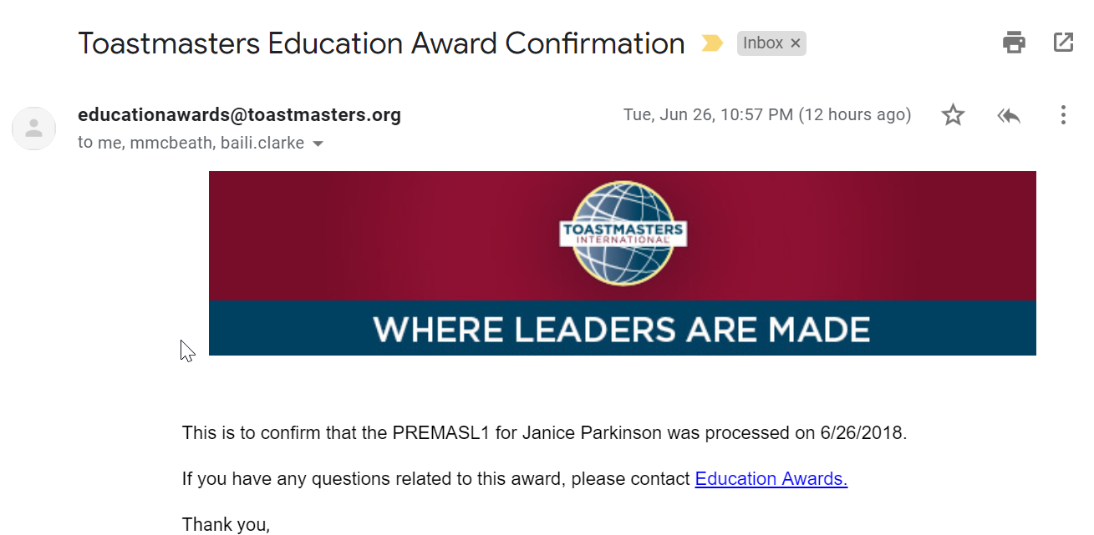
Receive an Education Award
Notes:
Finishing the level in basecamp doesn’t automatically create an education award for you or the club
Ask your VP Ed to submit for an award in Club Central
If you are a member in more than one club - you can chose which club gets the credit. It doesn’t have to be the same club as approved the Level 1 completion. (VP Ed’s beware and confirm with your member)
The email will be CC’d to the VP Ed and President.

Slide 28
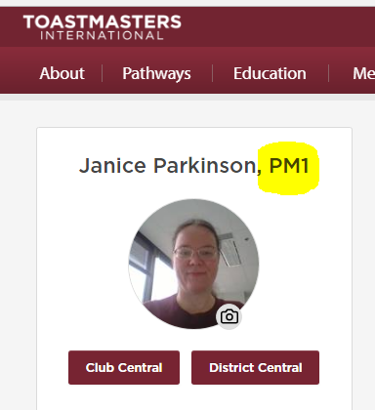
Celebrate a new designation
Notes:
The listed designation changed from the old “ACB” designation to PM1 - Presentation Mastery Level 1
I still have the old awards ACB, ALS. If I had had an old DTM – this designation would still show as DTM.

Slide 29
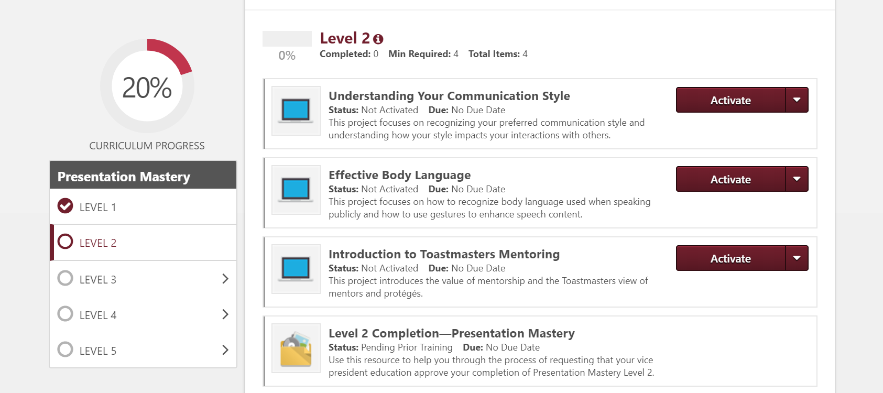
Start on Level 2
Notes:
Every path will have Introduction to Mentoring… other projects depend on the Path. Follow the same process to complete Level 2 ...

Slide 30
Review of Objectives
By the end of this module, you should be able to:
  Launch a project
  Complete a project
  Complete a level
Notes:
Instructor Tips
Review the objectives and summarize key points to remember as they relate to the objectives (use a separate summary slide if it’s helpful)
Ask participants to summarize in their own words, trying to assess what they learning and what some of them personally gained from it

Slide 31
“I will” Statements
Write one (or more) specific actions you will take based on the material
Describe the benefit you or others will receive
Example:
I will complete level one of my path in the next 3 months
so that I can progress with my Toastmasters Education
Notes:
Instructor Tips
The goal of a module is to change behavior, one way to support this is to ask participants to commit to doing that
The participants must each define their own behavior (not the instructor)
You can choose whether or not to ask if people want to state them publicly (or say them to others in groups, maybe with accountability)

Slide 32
Additional References and Resources
You can find more information at the following links:
  https://www.toastmasters.org/pathways-overview/ice-breaker
An excellent video of this process created by District 21
  https://www.youtube.com/watch?v=UBLQU6q0k2Q
Notes:
Instructor Tips
Provide a list of additional resources on the material: (eg. Books and web links) so participants can expand their knowledge

Slide 33
Evaluations
We want feedback on
  WWW—what went well…
  EBI—even better if…
  Please take a few minutes to fill out comments
Notes:
We may evaluate parts of the Kirkpatrick model
Reaction (initial, often via survey)
Learning—assessment (test) based on the objectives
Transfer—Assess application of skills (eg. 30 day survey)
Business results—district metrics
Instructor Tips
Use the evaluation to assess the material, delivery and participant learning
We hope to harvest and modify existing evaluation material for consistency, and provide guidance to instructors
We still need some sample evaluation templates for consistency

